Slide 1


Spotify Smart Playlist:
Next Track Prediction Pipeline
• End-to-End AWS ETL • PyTorch Modeling
• Analytics & Alerts

Slide 2
BUSINESS USE-CASE

Slide 3




BUSINESS USE-CASE
An automated AWS-native ETL + modeling stack that cleans Spotify JSON dumps, catalogs them in Athena, trains a PyTorch next-song classifier in SageMaker, and visualizes key insights in QuickSight.
Goal: Auto-extend user playlists with the “next” track they’ll love
KPI: Increase session duration & track completion rate
DeepLearning: Next Song Prediction based on previous songs
Data: Historical playlist JSON dumps → track URIs + metadata

Slide 4
END-TO-END
DATA PIPELINE ARCHITECTURE

Slide 5
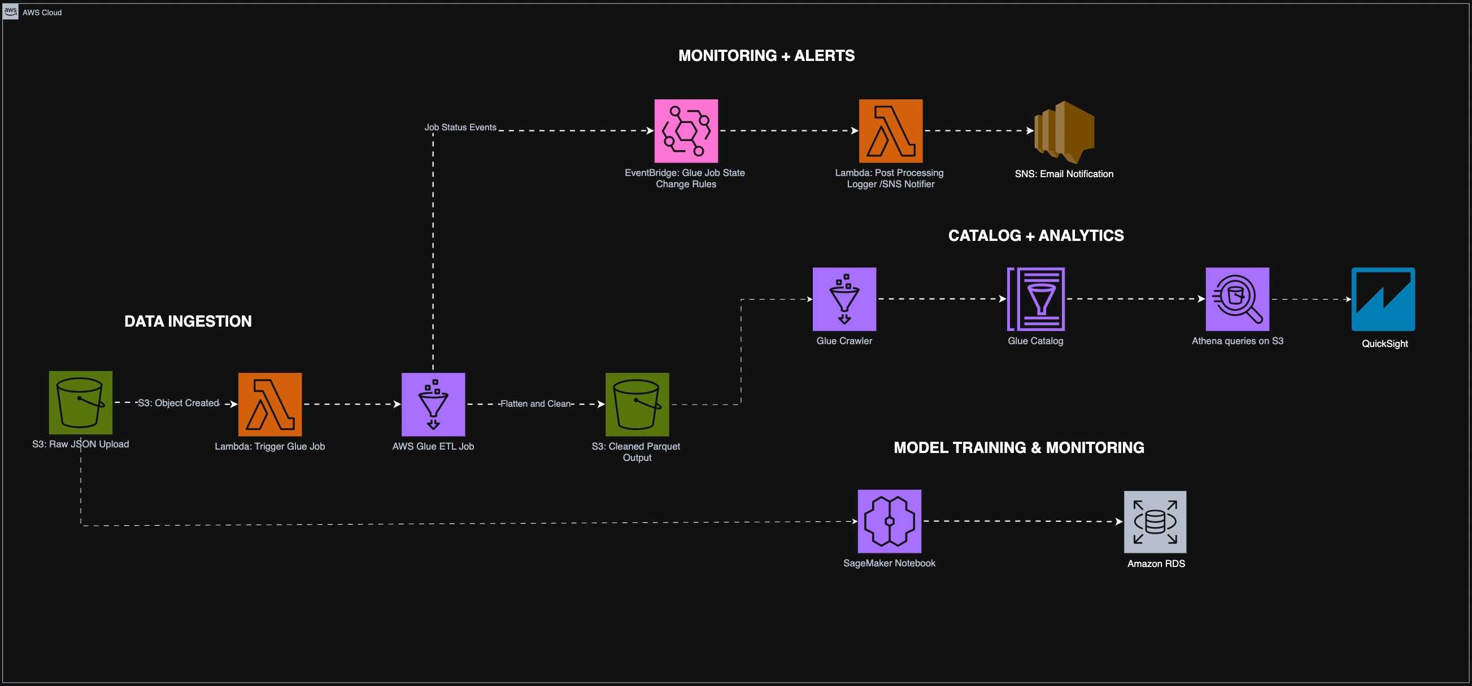
AWS Pipeline Architecture

Slide 6
RESOURCES USED
Ingestion: S3 raw-bucket ← JSON upload
Orchestration: Lambda on S3 → Glue Job trigger
ETL: Glue PySpark cleans & flattens → Parquet S3
Catalog & Query: Glue Crawler → Athena DDL → ad-hoc SQL
Modeling: SageMaker notebook + PyTorch training → model artifacts in RDS
Monitoring & Alerts: EventBridge → Lambda → SNS/email

Slide 7
IMPLEMENTATION

Slide 8
SOLUTION COMPONENTS
1. AWS Services & Rationale
S3: durable store for raw + Parquet
Lambda: lightweight orchestration & monitoring
Glue/ Athena: serverless ETL + SQL querying
SageMaker: hosted notebooks & managed PyTorch training
EventBridge & SNS: silent-fail alerts
2. ETL Design & Schema
JSON → StructType schema in Glue
Flatten nested “tracks” array → wide table
Partition by ingestion date for fast reads

Slide 9
SOLUTION COMPONENTS
3. Ingestion Mode
Batch: periodic JSON dumps from Spotify API
4. Security
IAM roles scoped to least privilege (Glue, SageMaker, Lambda)
S3 bucket policies locking down cross-account
5. Challenges & Mitigations
Schema drift: custom Glue classifiers + retries
Large vocab (50K songs): sparse‐embedding in PyTorch
Notebook Quotas: switched to direct Athena SQL

Slide 10
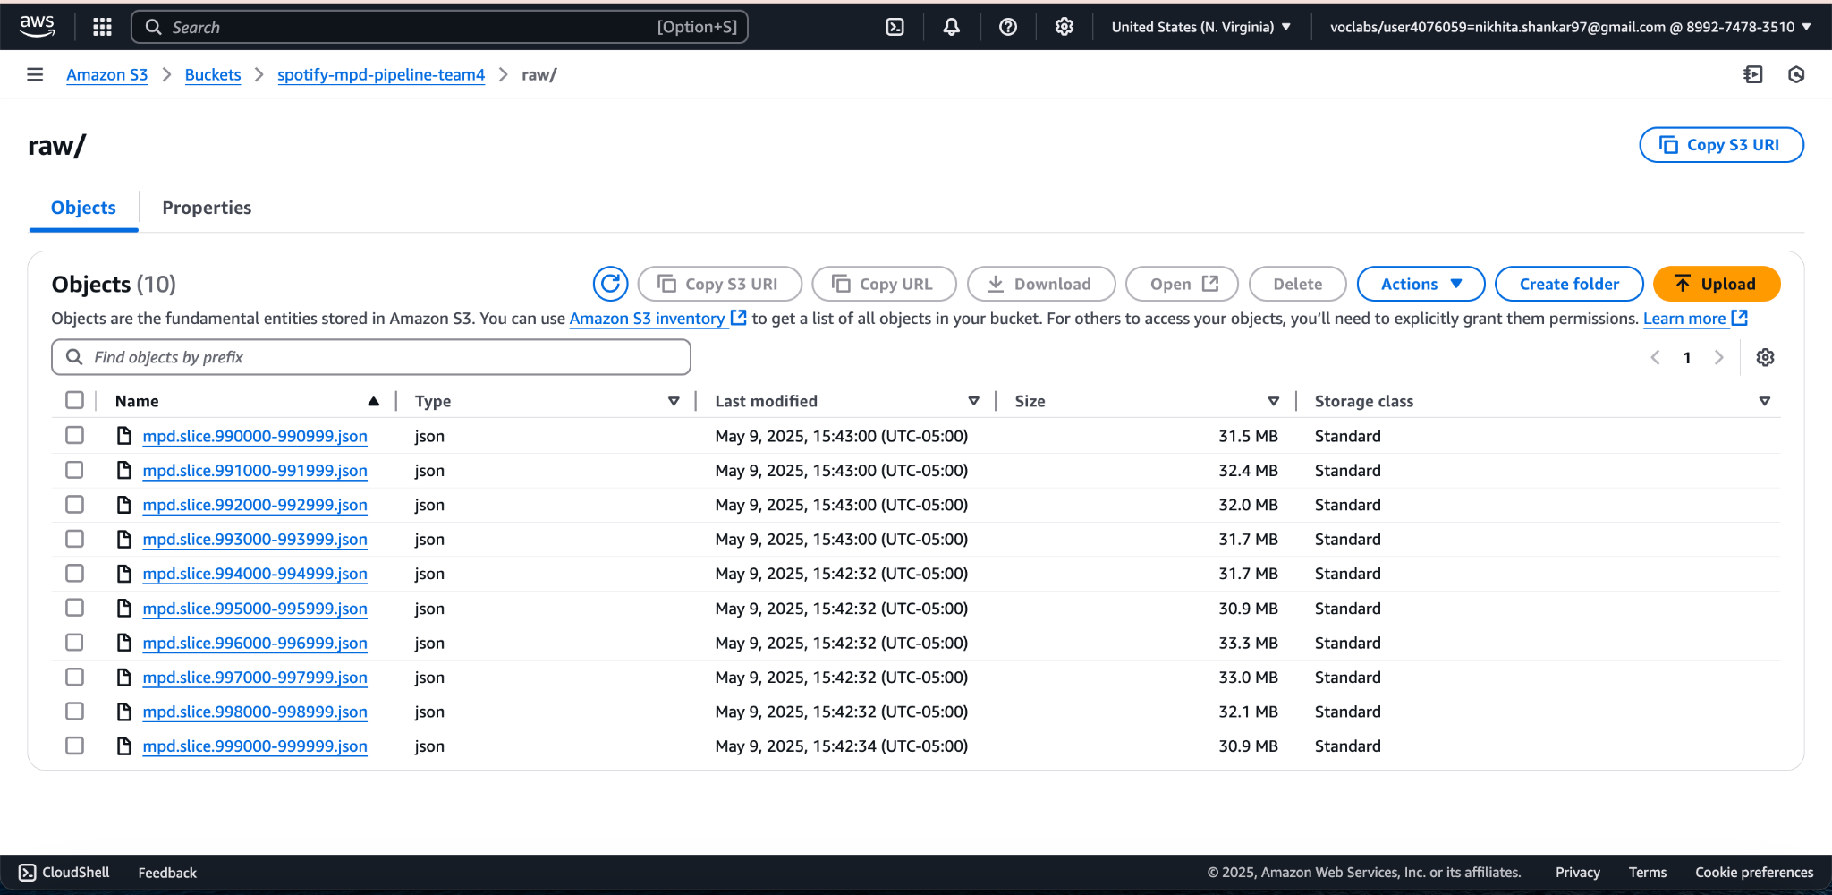
S3 INPUT BUCKET - SPOTIFY DATASET

Slide 11
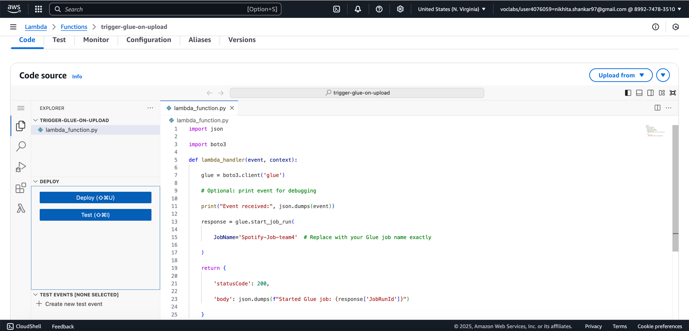
LAMBDA TRIGGER GLUE ETL JOB

Slide 12
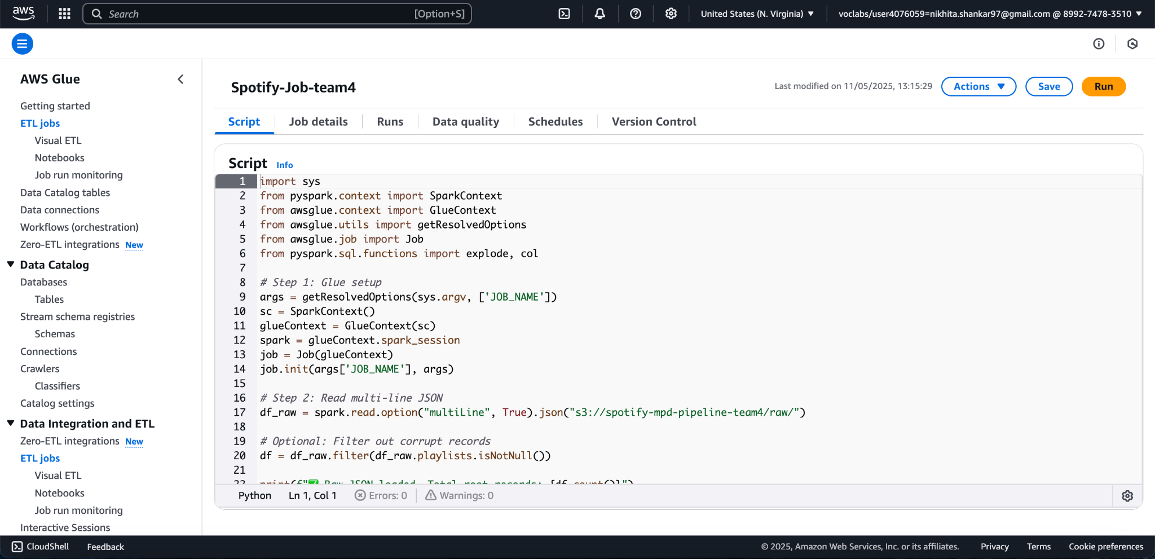
AWS Glue ETL Job to flatten JSON to Parquet

Slide 13
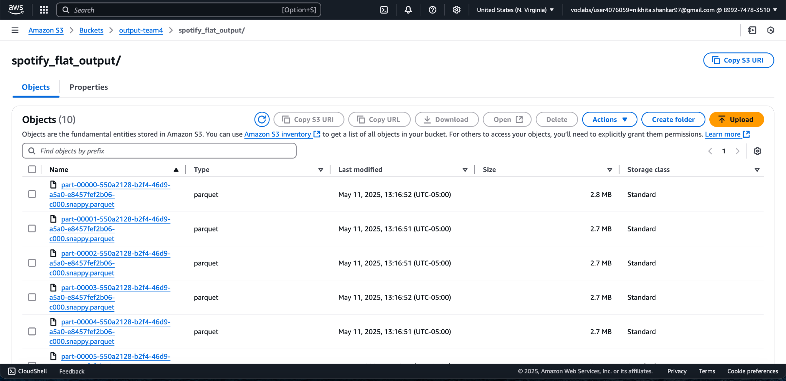
S3 OUTPUT BUCKET - JSON to PARQUET

Slide 14
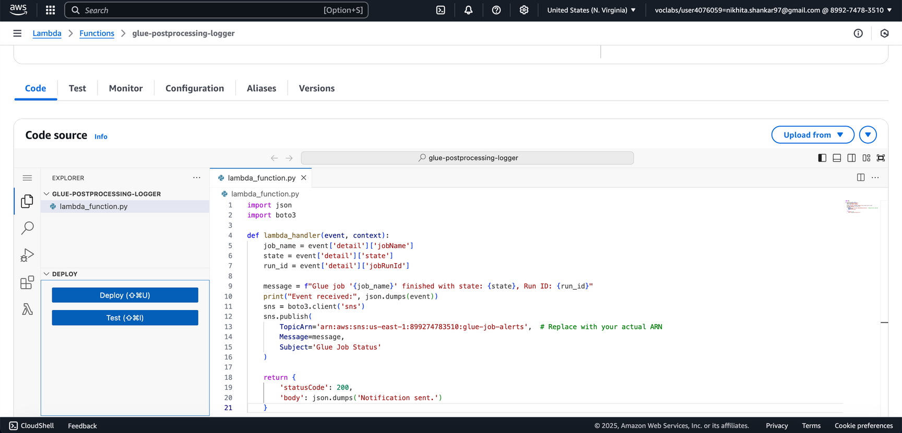
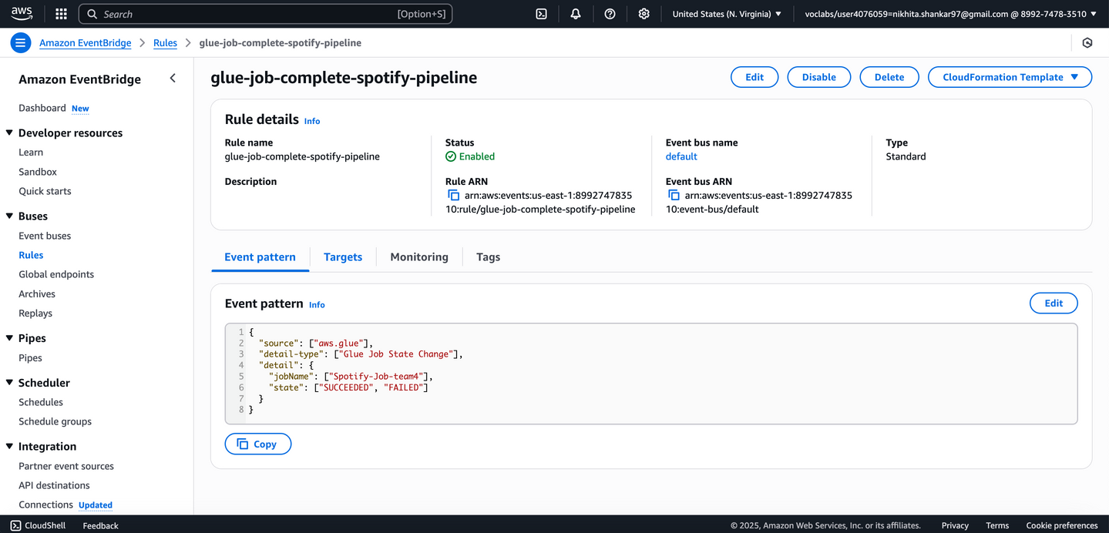
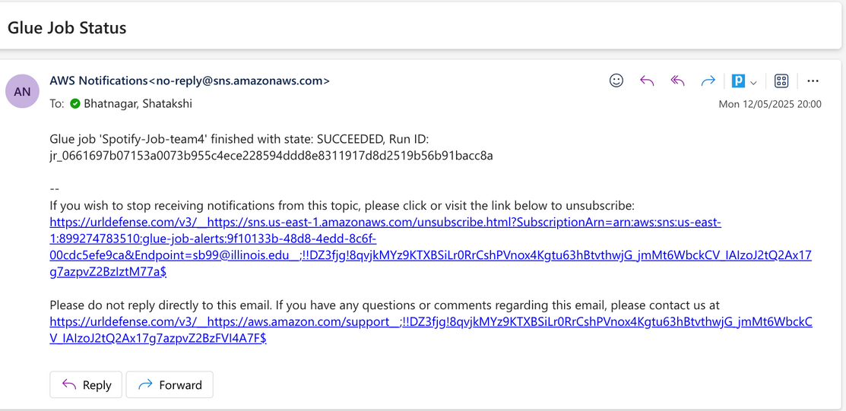
AWS Lambda Evoked with EventBridge & SNS

Slide 15
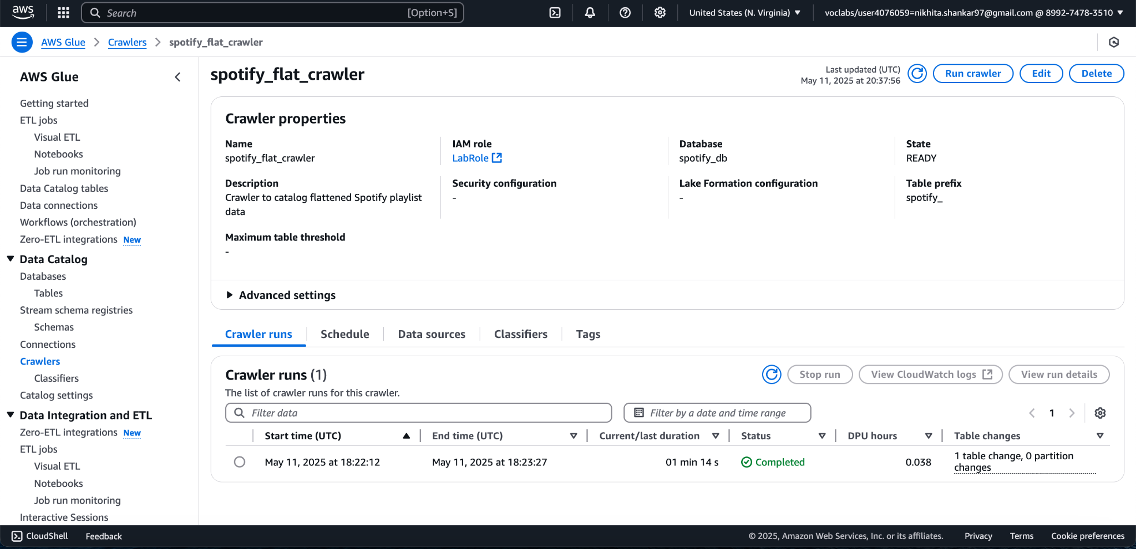
AWS GLUE CRAWLER

Slide 16
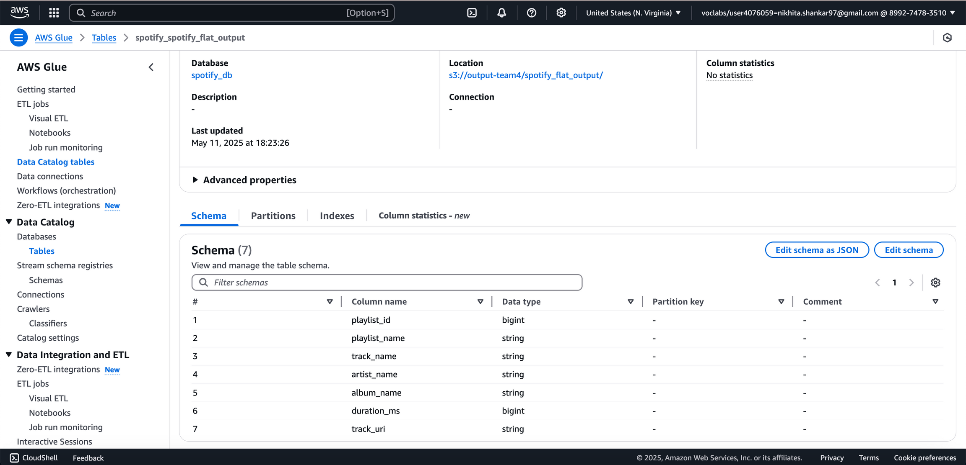
AWS GLUE CATALOG

Slide 17
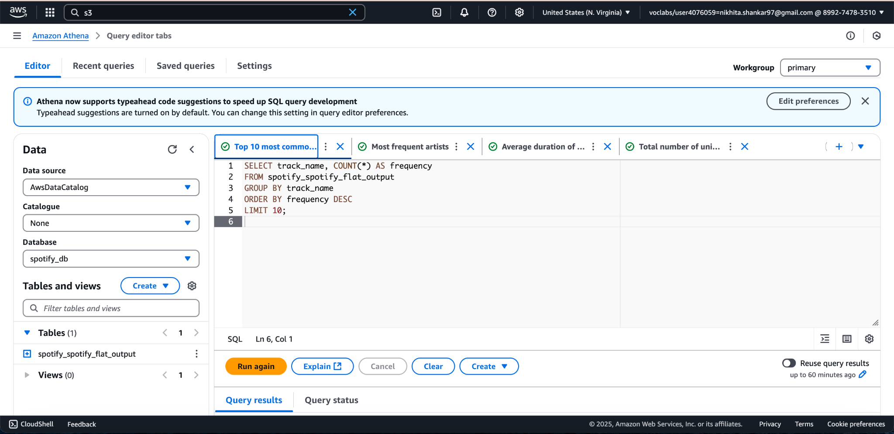
Top 10 most common track names

Slide 18





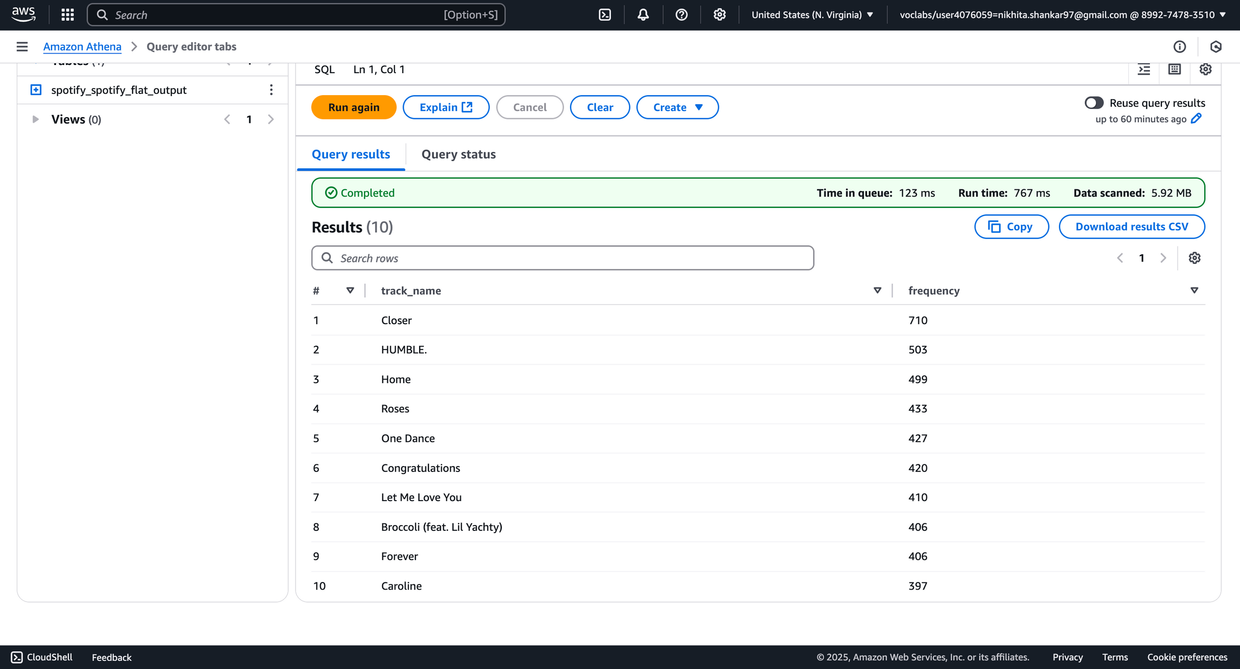


Upgrade
John Doe
Popular Tracks
#2 (Played 503 times)
#4 (Played 433 times)
# Top Results
#1 (Played 710 times)
#3 (Played 499 times)

Slide 19
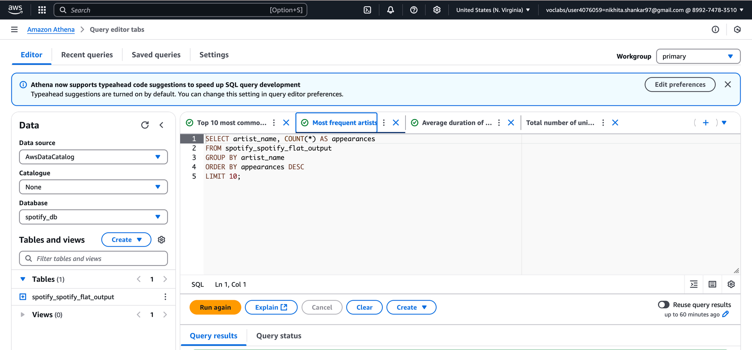
Most Frequent Artists

Slide 20


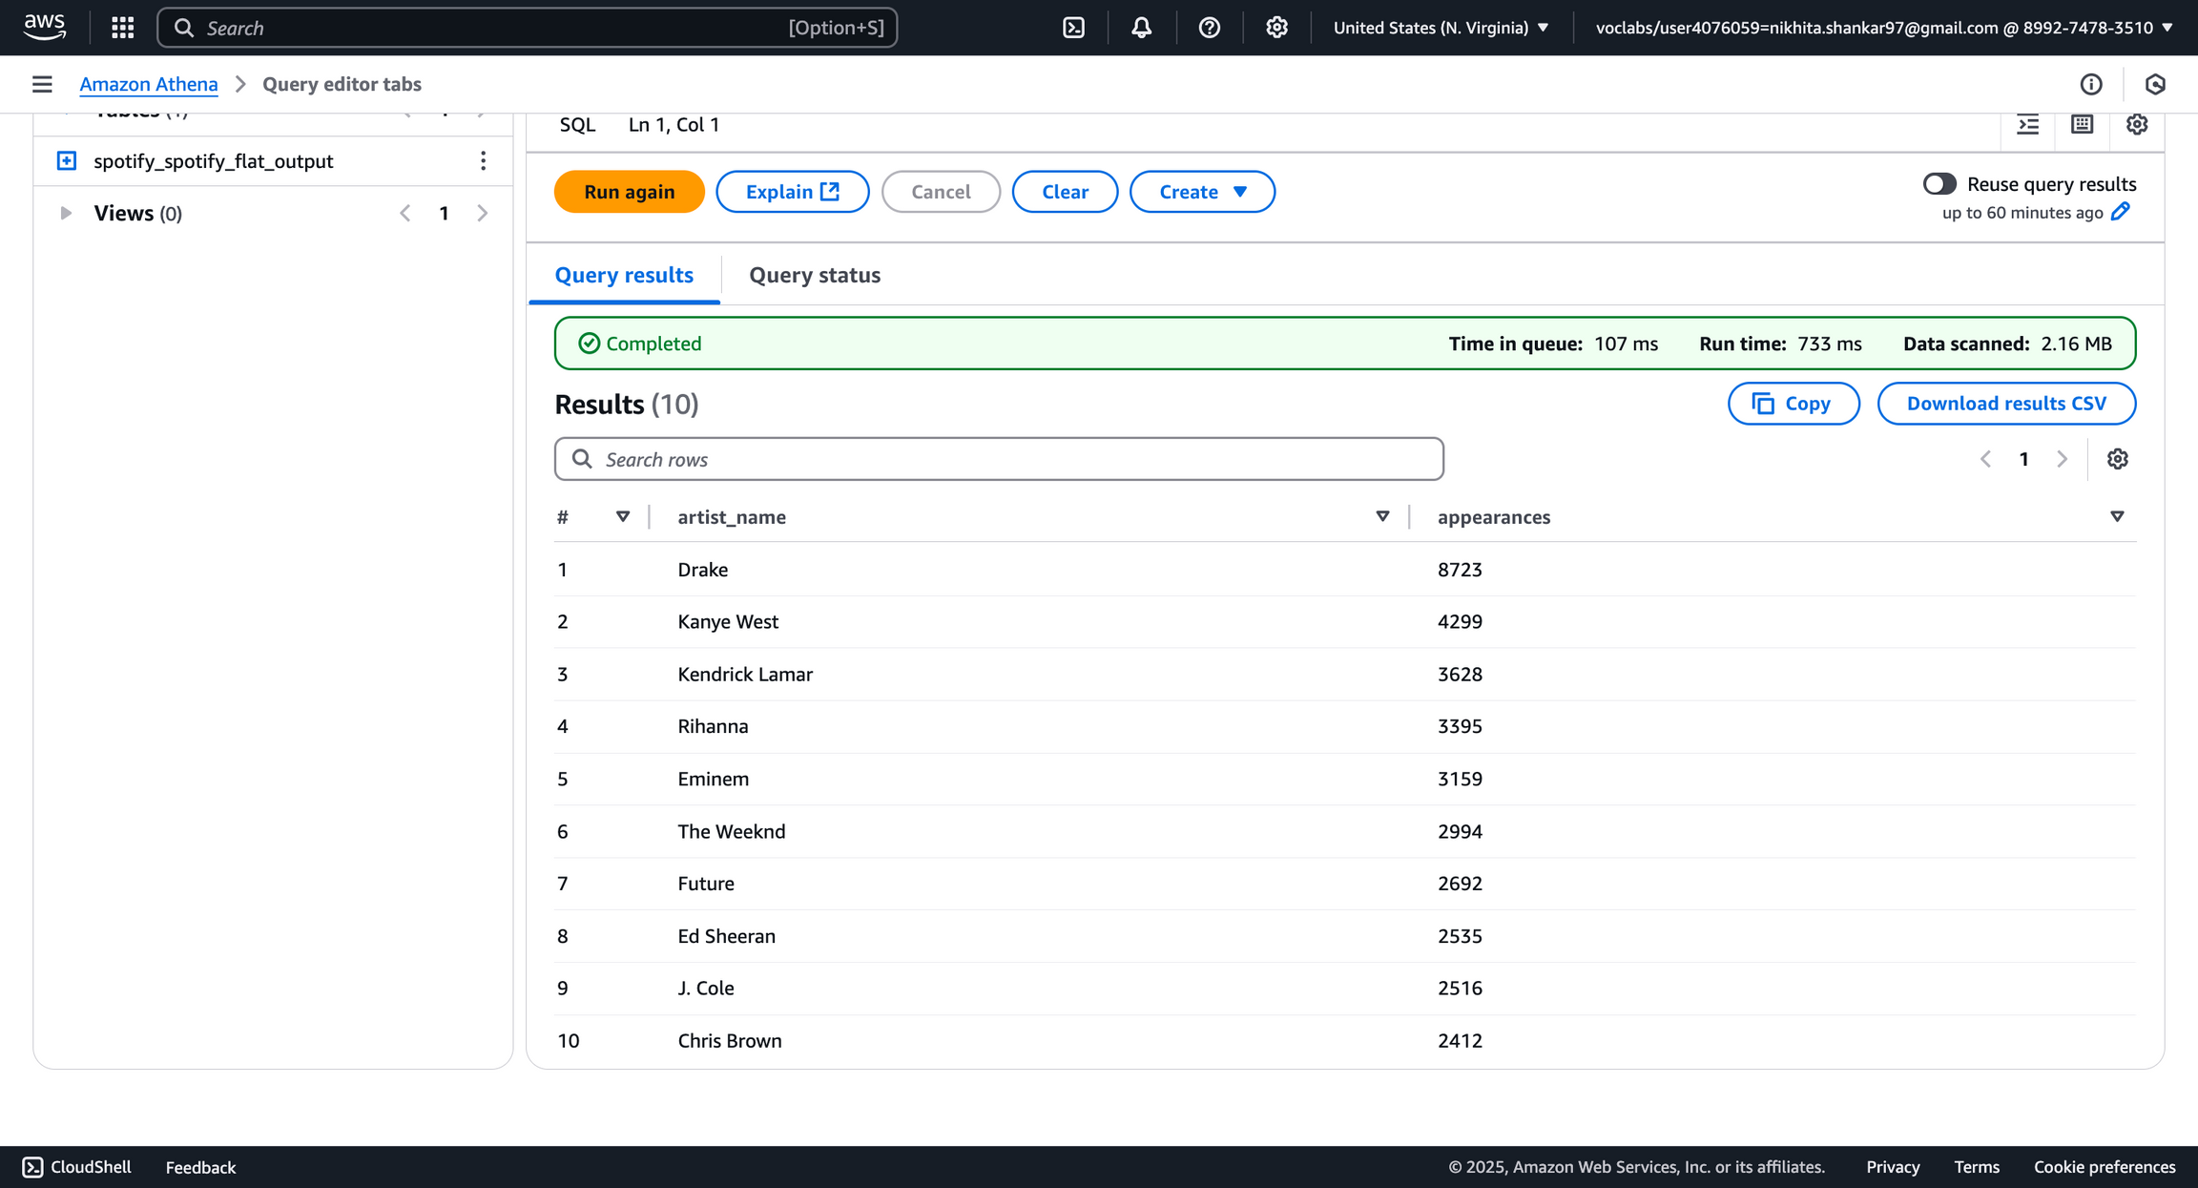


Upgrade
John Doe
Popular Artists
#2 (Appeared 4299 times)
#4 Appeared (3395 times)
# Top Results
#1 (Appeared 8723 times)
#3 (Appeared 3628 times)

Slide 21
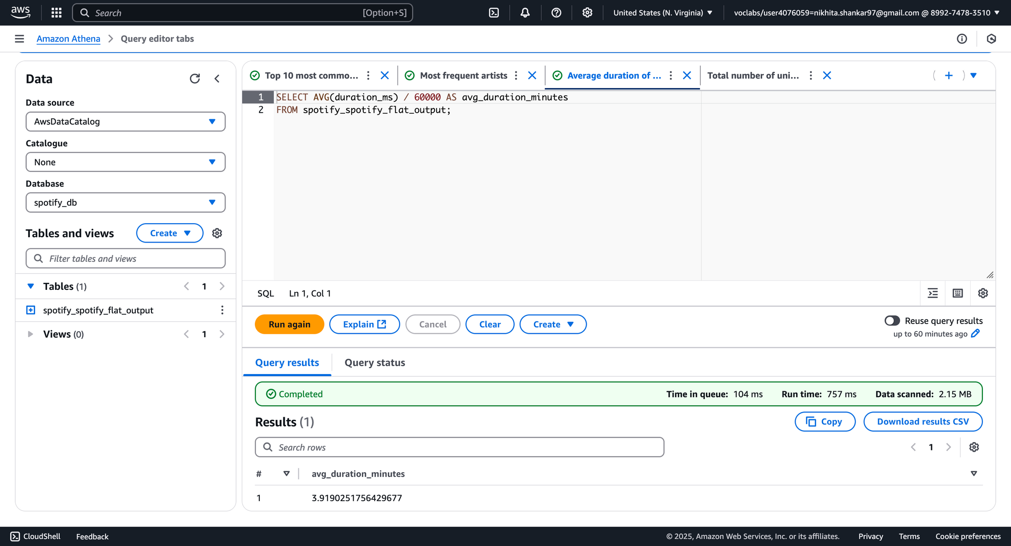
Average duration of tracks (in minutes)

Slide 22
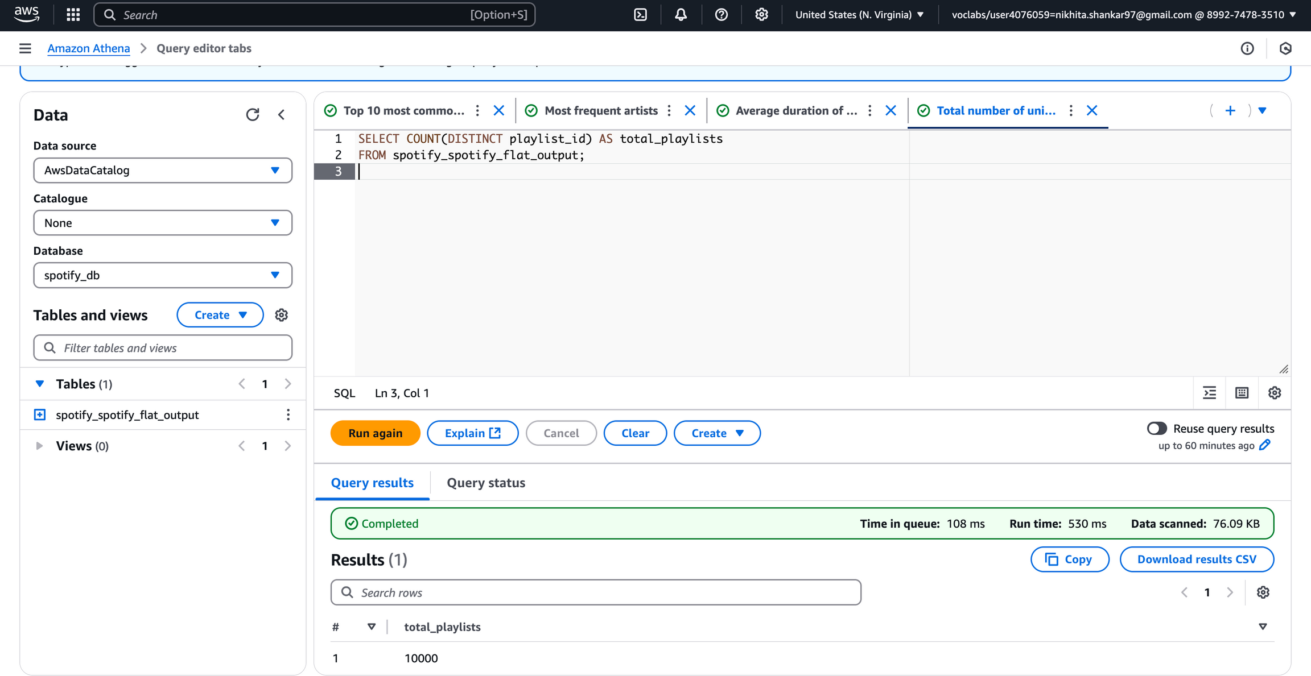
Total Number of Unique Playlists

Slide 23
SageMaker Model Training – High-Level Summary
Step 1: Load Data
Use a sample of playlist data (chunk_0.json) for quick training.
Step 2: Preprocess
Convert song URIs to numeric IDs and pad input sequences.
Step 3: Build Dataset
Create a PyTorch Dataset and DataLoader to feed data to the model.
Step 4: Define Model
A simple neural network that learns playlist patterns using embeddings.
Step 5: Train the Model
Use the Adam optimizer and CrossEntropy loss to train over multiple epochs.

Slide 24
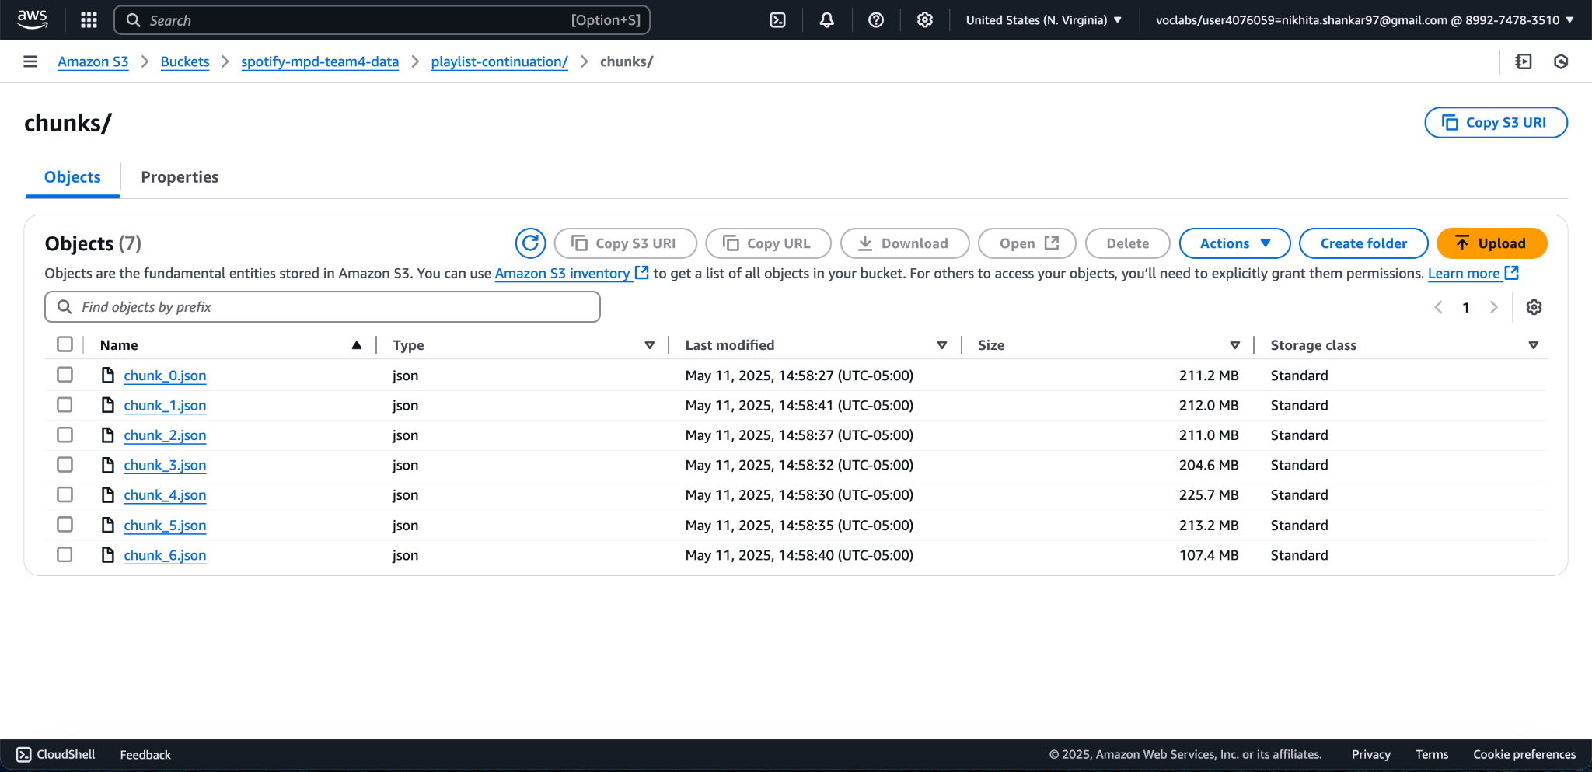
S3 Bucket that contains Chunked Dataset

Slide 25
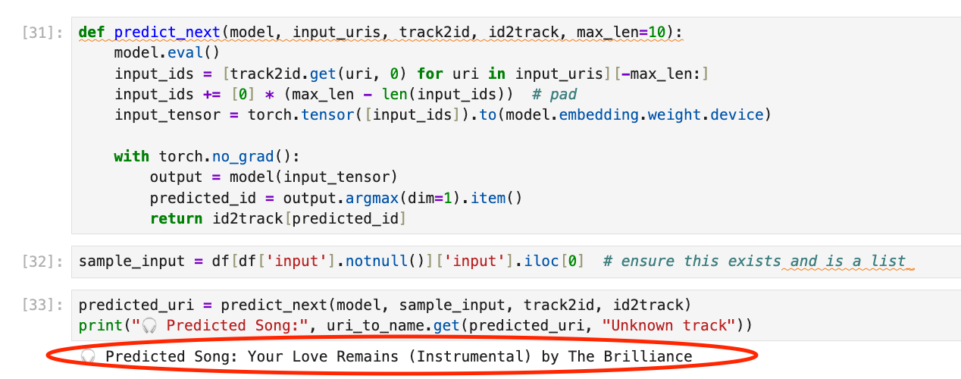
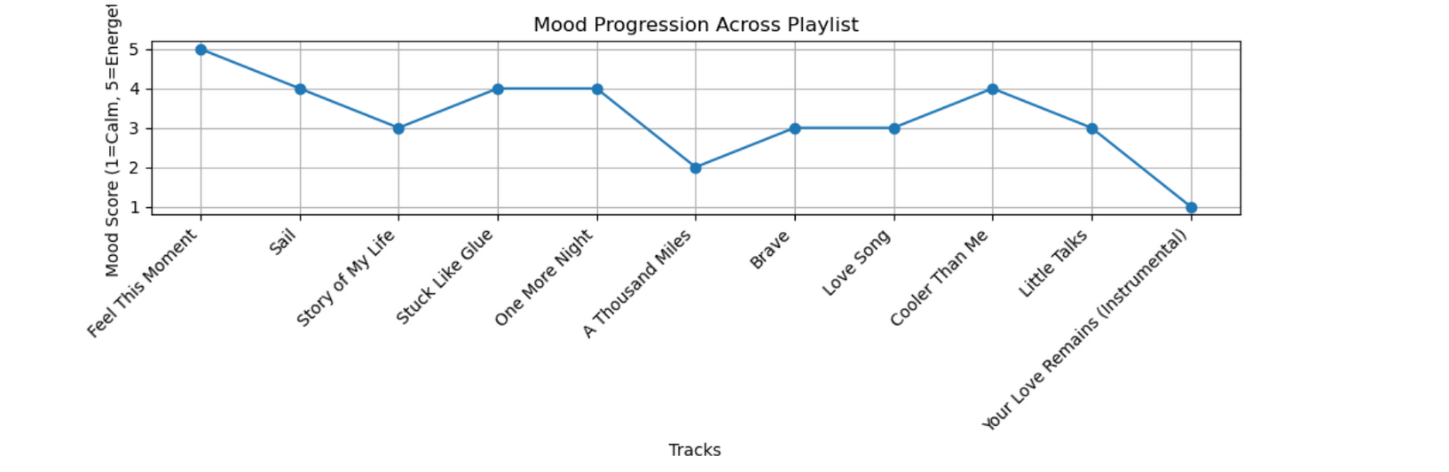
PREDICTION RESULTS

Slide 26
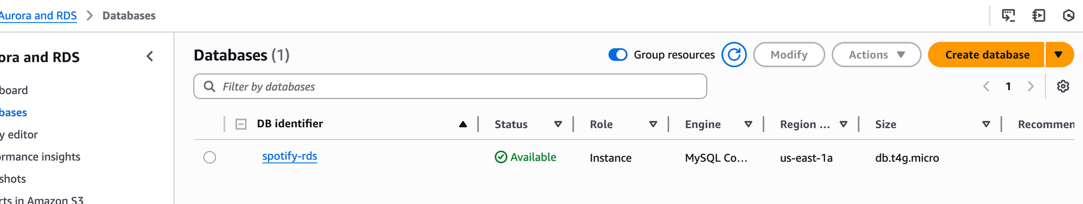
Structured Storage with Amazon RDS
Created a MySQL RDS instance named spotify-rds
Connected to RDS from SageMaker using mysql.connector
Used it to store processed playlist data and predicted songs
Enables easy querying and structured storage for further use

Slide 27
VISUALIZATION & INSIGHTS

Slide 28
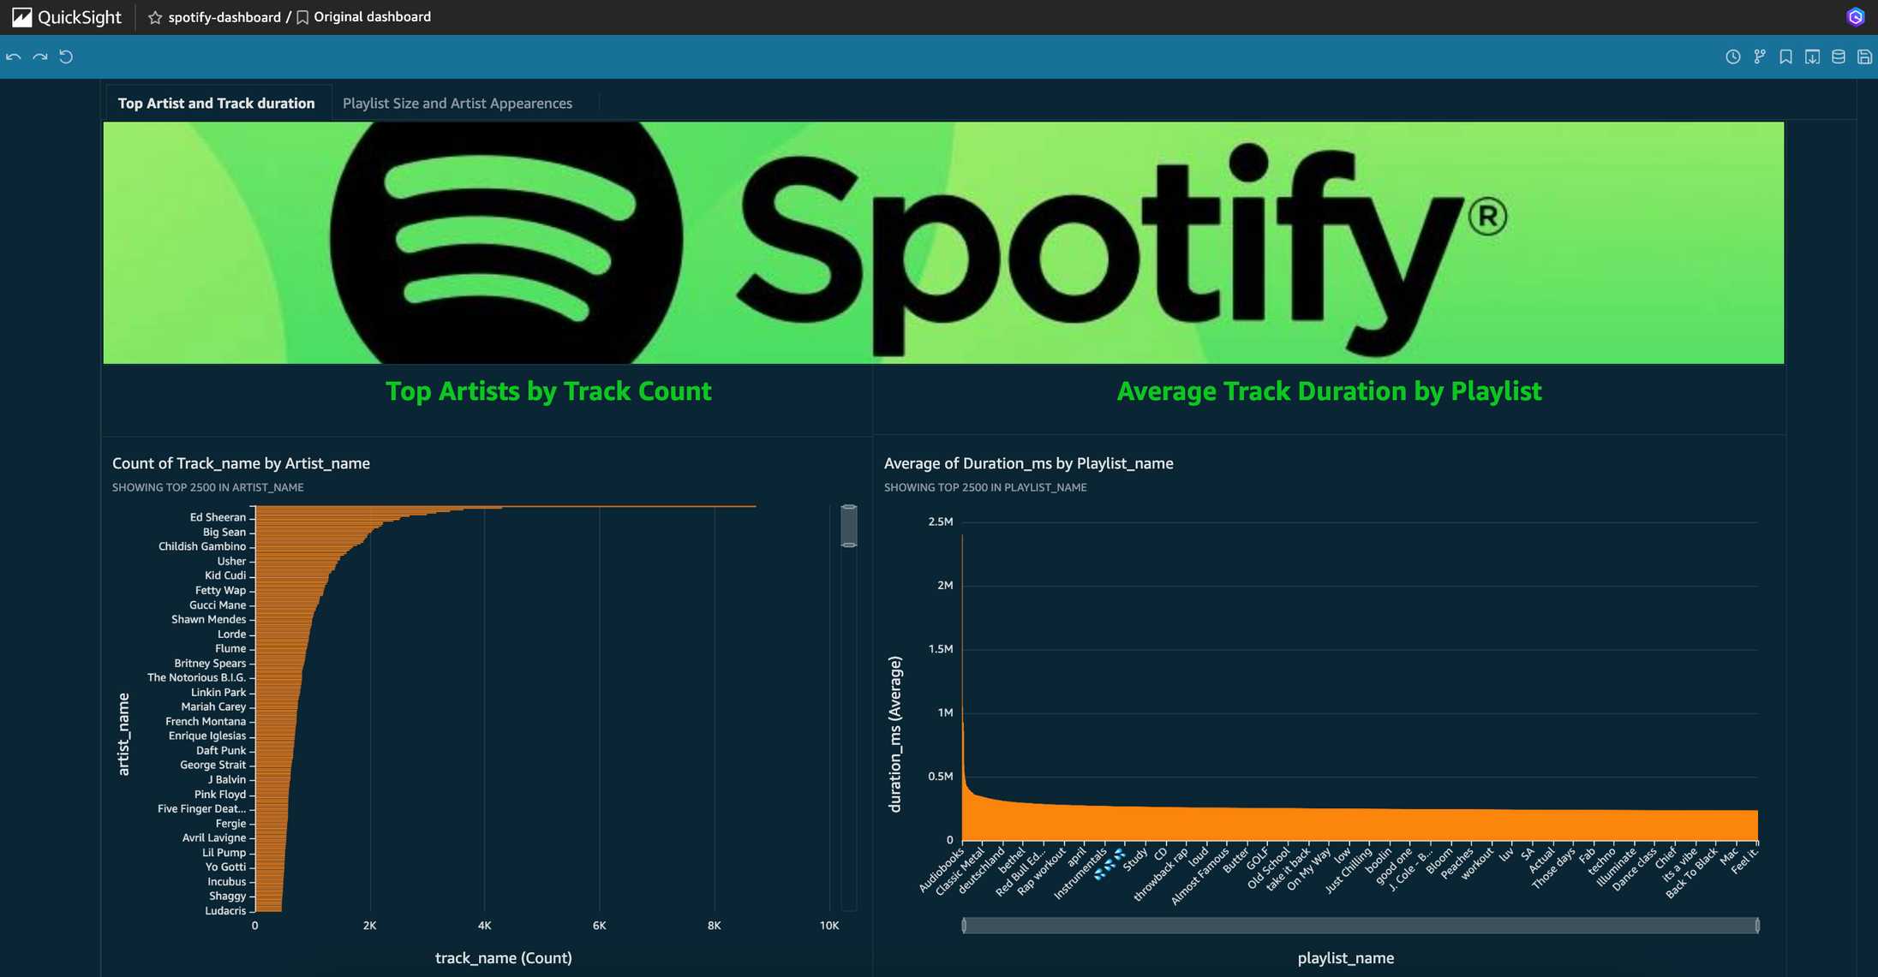
QuickSight Dashboard

Slide 29
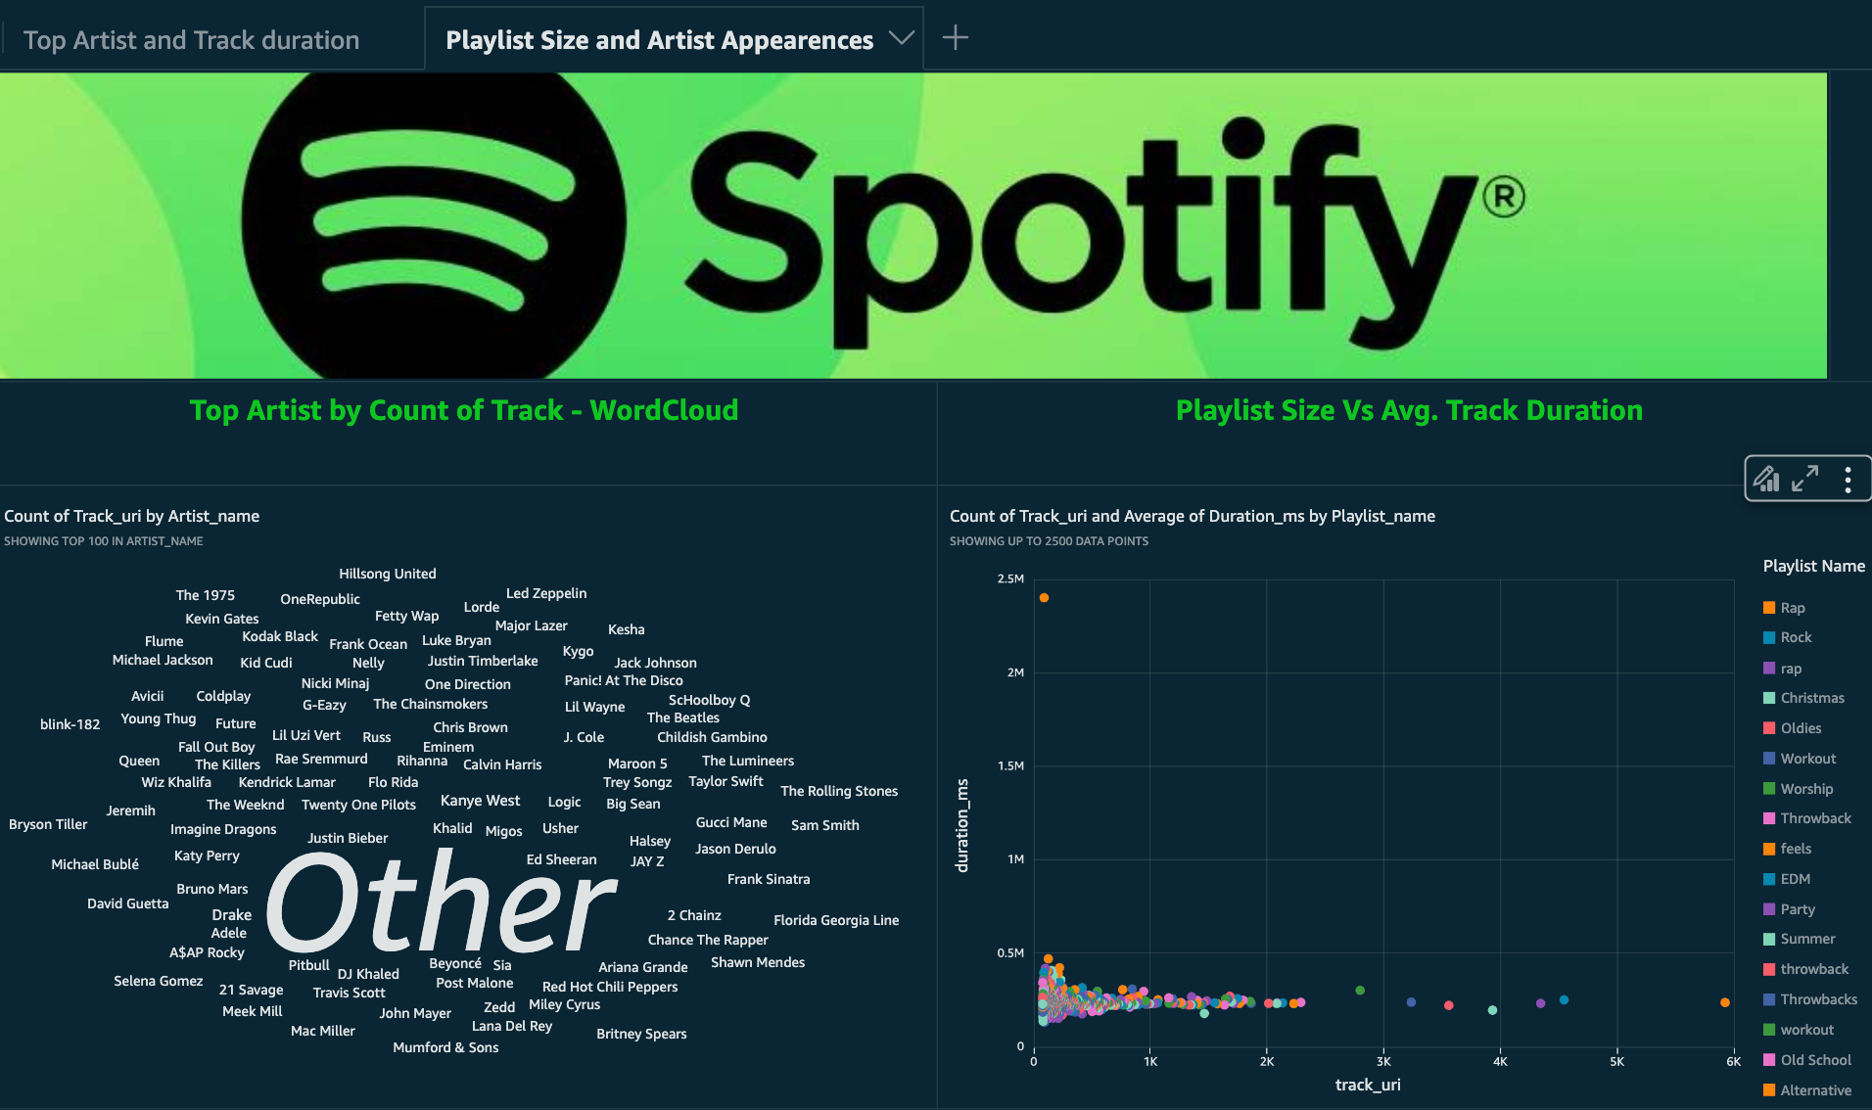
QuickSight Dashboard

Slide 30
Key Business Insights from Analysis
Artist Skew: Top 5 artists (e.g., Ed Sheeran) account for the bulk of track appearances; most artists appear <2K times.
Playlist Length ≠ Track Length: Average song duration clusters ~3–5 min across playlists; outliers exist (instrumental/live sessions)
Emergent Stars: Word cloud of top-100 artists surfaces both mega-stars and rising acts (e.g., Kygo, Panic! At The Disco).
Mood Dynamics: Line-chart shows energy peaks mid-playlist and tapers off; next-song predictor selected a calm instrumental fitting that down-slope.
Model Validation: PyTorch sequence model captures both co-occurrence and temporal mood trends in “what comes next.”

Slide 31
CONCLUSION & NEXT STEPS

Slide 32











k
Upgrade
BADM 358
Welcome
About Us
Conclusion & Next Steps
Our Teams
Agenda
Our Services
Automated Stack: S3 → Lambda → Glue → Athena → SageMaker → QuickSight delivers end-to-end data-to-insight flow.
Business Value: Drives personalized, mood-aware recommendations and highlights long-tail artists.
Future Enhancements: Add real-time inference endpoint, user-engagement signals, and genre-aware embeddings.
Achievements
Our Goals
Gallery
Pricing
Contact Us
Play
Follow

